Slide 1
Software Metrics and Measurement

Slide 2
Quality planning
A quality plan sets out the desired product qualities and how these are assessed and defines the most significant quality attributes.
The quality plan should define the quality assessment process.
It should set out which organisational standards should be applied and, where necessary, define new standards to be used.

Slide 3
Quality plans
Quality plan structure
  Product introduction;
  Product plans;
  Process descriptions;
  Quality goals;
  Risks and risk management.
Quality plans should be short, succinct documents
  If they are too long, no-one will read them.

Slide 4
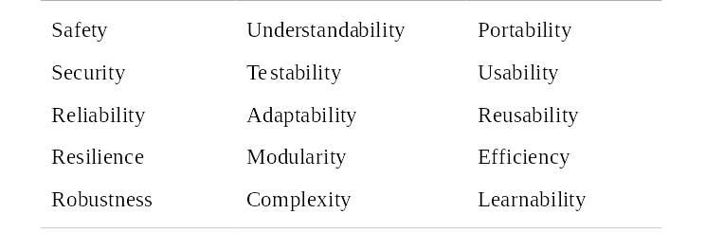
Software quality attributes

Slide 5
Quality control
This involves checking the software development process to ensure that procedures and standards are being followed.
There are two approaches to quality control
  Quality reviews;
  Automated software assessment and software measurement.

Slide 6
Quality reviews
This is the principal method of validating the quality of a process or of a product.
A group examines part or all of a process or system and its documentation to find potential problems.
There are different types of review with different objectives
  Inspections for defect removal (product);
  Reviews for progress assessment (product and process);
  Quality reviews (product and standards).

Slide 7
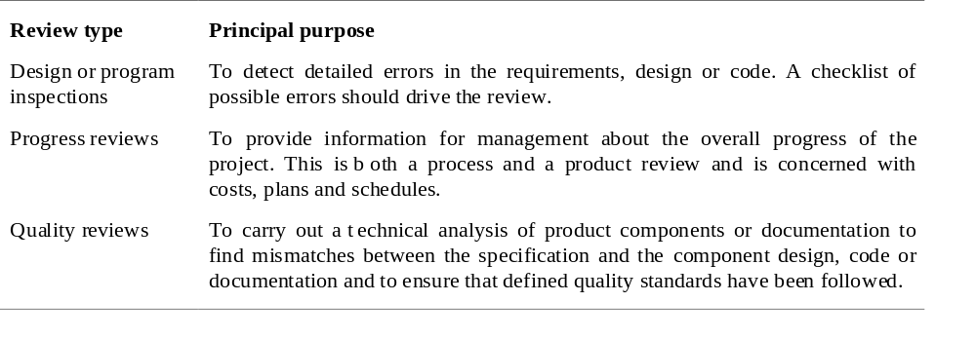
Types of review

Slide 8
Quality reviews
A group of people carefully examine part or all
of a software system and its associated
documentation.
Code, designs, specifications, test plans,
standards, etc. can all be reviewed.
Software or documents may be 'signed off' at a
review which signifies that progress to the next
development stage has been approved by
management.

Slide 9
Review functions
Quality function - they are part of the general quality management process.
Project management function - they provide information for project managers.
Training and communication function - product knowledge is passed between development team members.

Slide 10
Quality reviews
The objective is the discovery of system defects and inconsistencies.
Any documents produced in the process may be reviewed.
Review teams should be relatively small and reviews should be fairly short.
Records should always be maintained of quality reviews.

Slide 11
Review results
Comments made during the review should be
classified
  No action. No change to the software or documentation is
  required;
  Refer for repair. Designer or programmer should correct an identified fault;
  Reconsider overall design. The problem identified in the
  review impacts other parts of the design. Some overall
  judgement must be made about the most cost-effective way of solving the problem;
Requirements and specification errors may
have to be referred to the client.

Slide 12
Software measurement and metrics
Software measurement is concerned with deriving a numeric value for an attribute of a software product or process.
This allows for objective comparisons between techniques and processes.
Although some companies have introduced measurement programmes, most organisations still don’t make systematic use of software measurement.
There are few established standards in this area.

Slide 13
Software metric
Any type of measurement which relates to a software system, process or related documentation
  Lines of code in a program, the Fog index, number of person-days required to develop a component.
Allow the software and the software process to
be quantified.
May be used to predict product attributes or to control the software process.
Product metrics can be used for general predictions or to identify anomalous components.

Slide 14
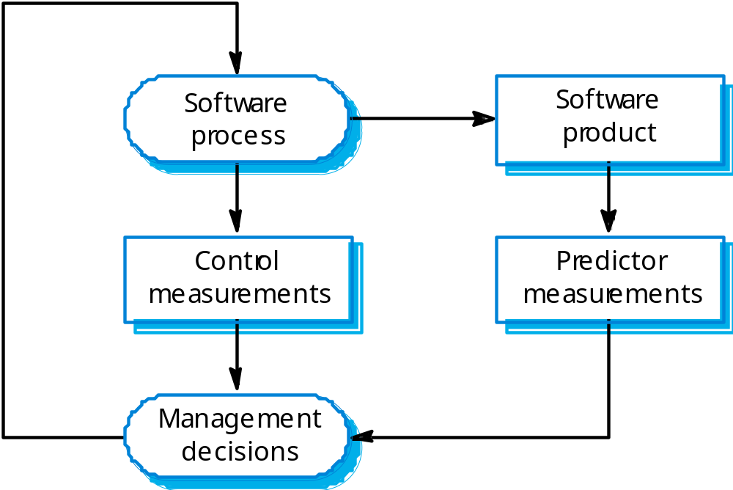
Predictor and control metrics

Slide 15
Metrics assumptions
A software property can be measured.
The relationship exists between what we can
measure and what we want to know. We can only measure internal attributes but are often more interested in external software attributes.
This relationship has been formalised and
validated.
It may be difficult to relate what can be measured to desirable external quality attributes.

Slide 16
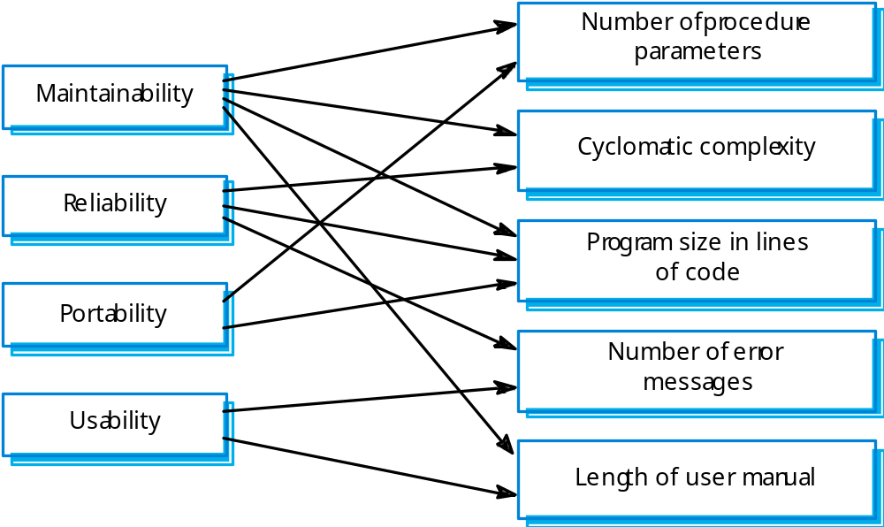
Internal and external attributes

Slide 17
The measurement process
A software measurement process may be part of a quality control process.
Data collected during this process should be maintained as an organisational resource.
Once a measurement database has been established, comparisons across projects become possible.

Slide 18
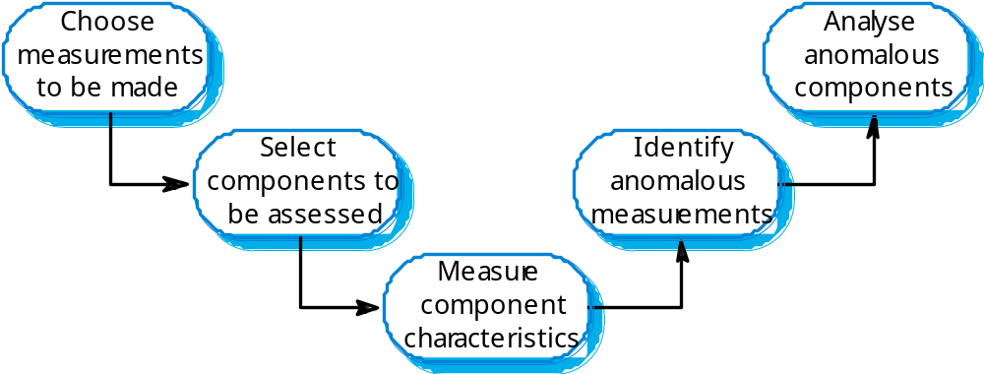
Product measurement process

Slide 19
Data collection
A metrics programme should be based on a set of product and process data.
Data should be collected immediately (not in retrospect) and, if possible, automatically.
Three types of automatic data collection
  Static product analysis;
  Dynamic product analysis;
  Process data collation.

Slide 20
Data accuracy
Don’t collect unnecessary data
  The questions to be answered should be decided in advance and the required data identified.
Tell people why the data is being collected.
  It should not be part of personnel evaluation.
Don’t rely on memory
  Collect data when it is generated not after a project has finished.

Slide 21
Product metrics
A quality metric should be a predictor of
product quality.
Classes of product metric
  Dynamic metrics which are collected by measurements made of a program in execution;
  Static metrics which are collected by measurements made of the system representations;
  Dynamic metrics help assess efficiency and reliability; static metrics help assess complexity, understandability and maintainability.

Slide 22
Dynamic and static metrics
Dynamic metrics are closely related to software quality attributes
  It is relatively easy to measure the response time of a system (performance attribute) or the number of failures (reliability attribute).
Static metrics have an indirect relationship with quality attributes
  You need to try and derive a relationship between these metrics and properties such as complexity, understandability and maintainability.

Slide 23
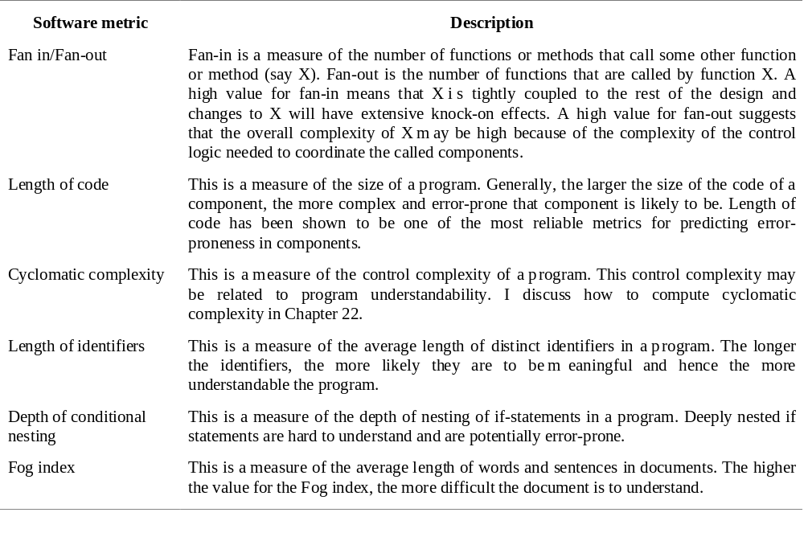
Software product metrics

Slide 24
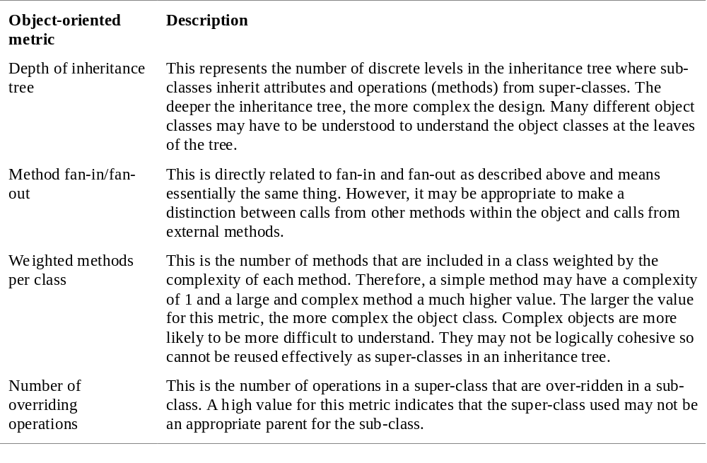
Object-oriented metrics

Slide 25
Key points
Reviews are the most widely used approach for assessing software quality.
Software measurement gathers information about both the software process and the software product.
Product quality metrics should be used to identify potentially problematical components.
There are no standardised and universally applicable software metrics.

